Slide 1

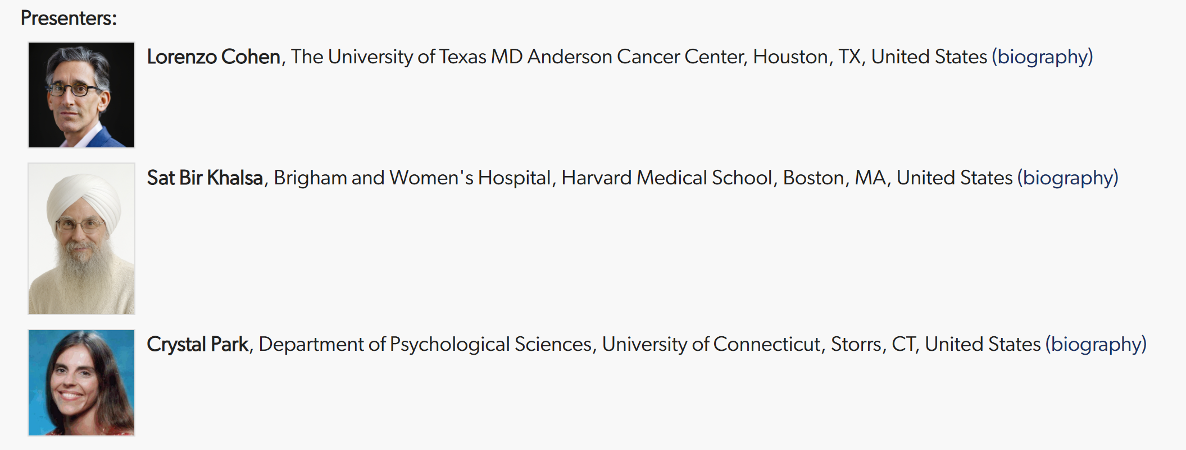

Slide 2


Brigham and Women’s Hospital
Founding Member, Mass General Brigham
Harvard Medical School
Introduction to Yoga and Spirituality
ICIMH 2025 Symposium S25
Yoga and Spirituality:
The Underlying Psychophysiology and the Research Evidence
in Healthy and Patient Populations
March 6, 2025
Sat Bir S. Khalsa, Ph.D.
Associate Professor of Medicine, Harvard Medical School
Director of Research, Kundalini Research Institute
Editor in Chief, International Journal of Yoga Therapy
Research Associate, Benson Henry Institute for Mind Body Medicine
Research Affiliate, Osher Center for Integrative Medicine

Slide 3
Spirituality and it’s Relevance for Health Care

Slide 4

“Spirituality and religion are often used interchangeably, but the two concepts are different.”
“Some authors agreed that religion involves an organized entity, such as an institution with certain rituals, values, practices, and beliefs about God or a higher power. Religions also have deﬁnable boundaries and may provide guidelines to which individuals adhere.”
“Conversely, many authors acknowledge that spirituality involves an individual’s search for meaning in life, wholeness, peace, individuality, and harmony, and is a biological, and integral component of being human. Spirituality is also described as a way of being; an energizing force that propels individuals to reach their optimal potential; a meaningful and extensive way of knowing the world; and is expressed through several personal mechanisms such as meditation…”

Slide 5
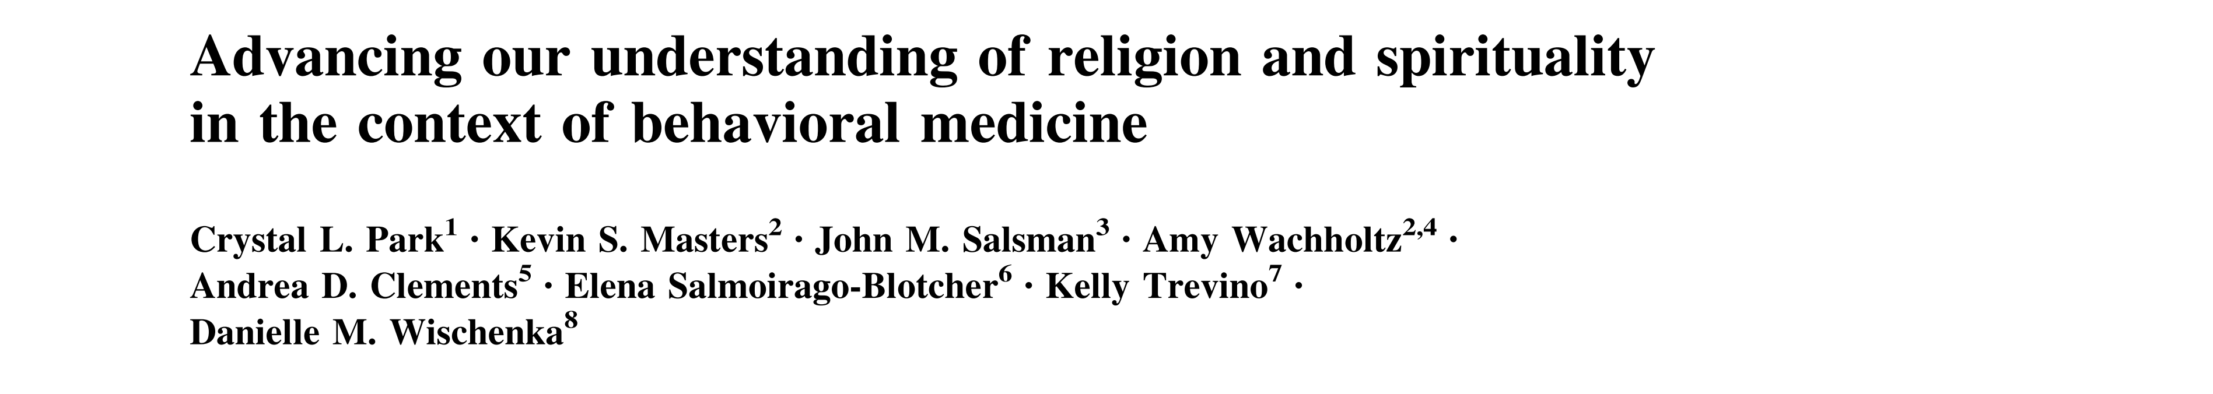
“Recognizing and understanding the potentially powerful roles that religiousness and spirituality (RS) may serve in the prevention and amelioration of disease, as well as symptom management and health related quality of life, signiﬁcantly enhances research and clinical efforts across many areas of behavioral medicine.”

Slide 6
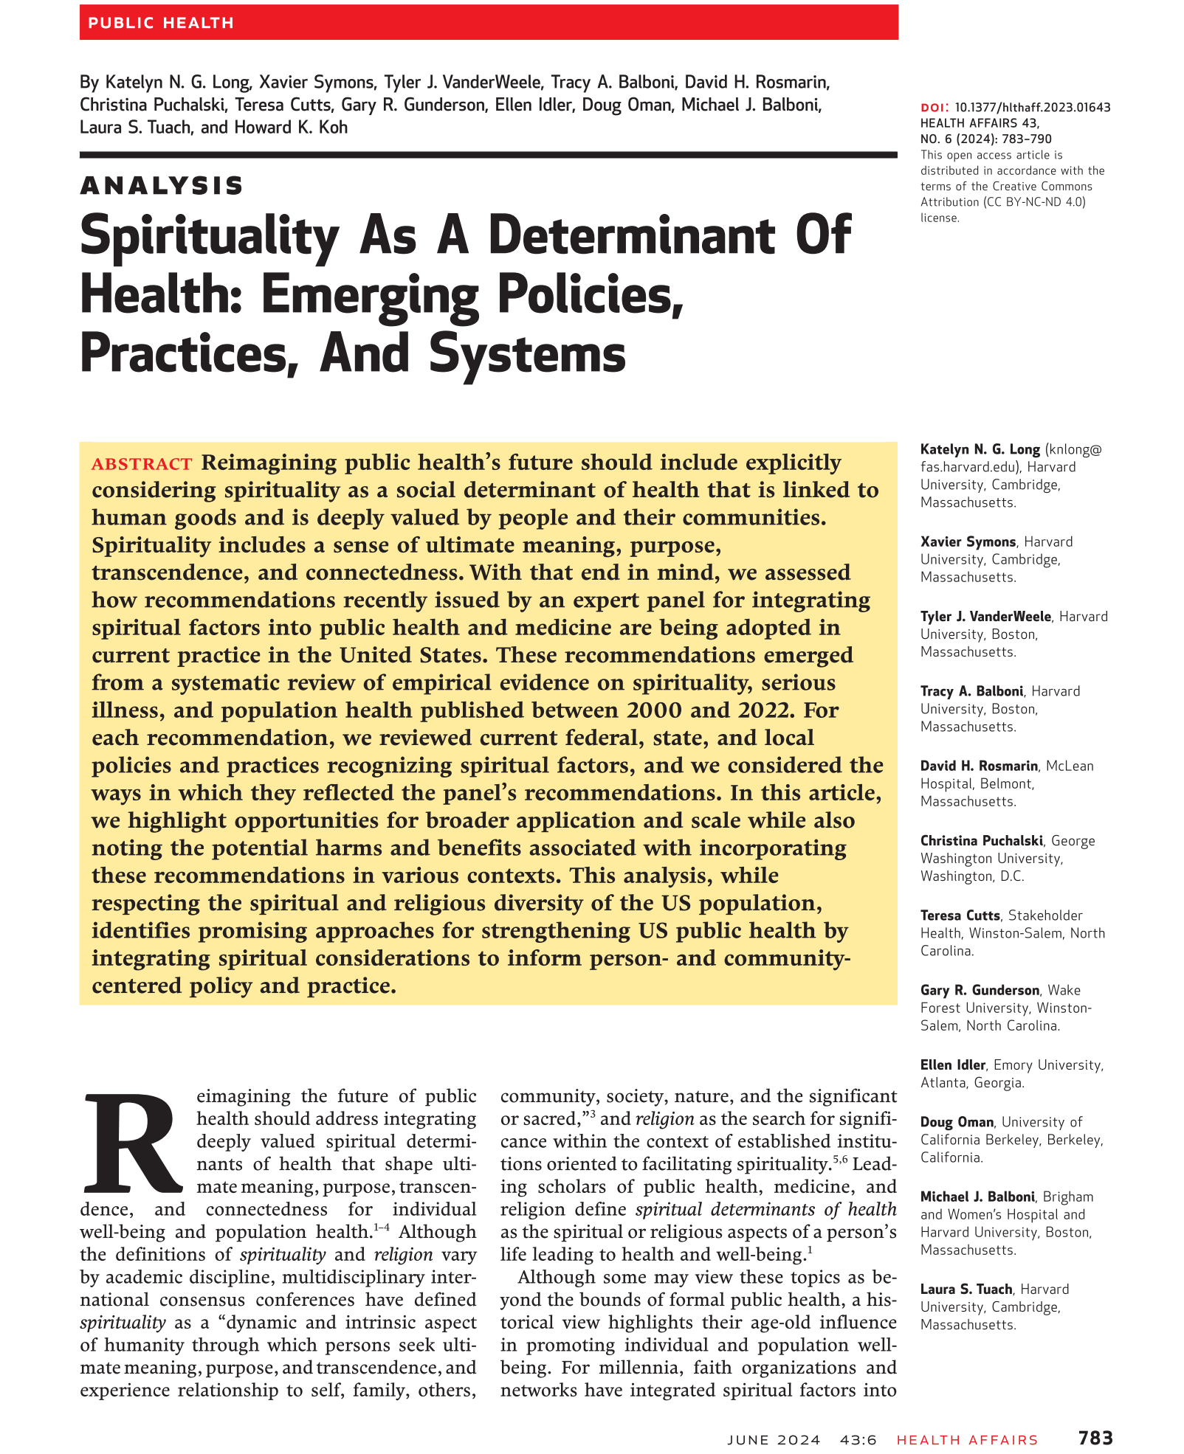
“Reimagining the future of public health should address integrating deeply valued spiritual determinants of health that shape ultimate meaning, purpose, transcendence, and connectedness for individual
well-being and population health.”

Slide 7

https://www.nccih.nih.gov/about/offices/od/director/past-messages/including-spirituality-into-a-fuller-picture-of-research-on-whole-person-health?nav=govd

Slide 8

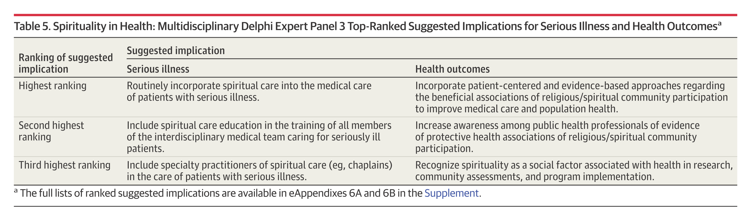

Slide 9




“The past few decades have seen an international revival of interest in the role of spirituality in patient care. … I believe this trend is salutary for patients and health care professionals alike.”

Slide 11
Contemplative
States

Slide 12
The Mystical Experience
“They are transient states of consciousness, usually lasting for only a few minutes and distinctly different from normal consciousness. The person typically experiences them passively, not a product of personal will or control, and has a difficult time expressing the experience in words. They usually are intensely positive, joyful experiences, and often the person senses the presence of an awe-inspiring transcendent Other. Often there is a noetic element of revelation, a sudden knowing of a new truth. An experience of unity is common; for example, an ineffable oneness with all of humankind, with nature, or the universe.”
From: The phenomenon of quantum change. Miller WR, Journal of Clinical Psychology 60:453-60, 2004.

Slide 13
The Mystical Experience
Samadhi
Sahaja
Nirvana
Turiya
Moksha
Bodhi
Satori
Mystical State
Unitive State
Enlightenment
Kundalini Awakening
Spiritual Awakening
Transcendence
Peak Experience
Cosmic Consciousness
Universal Consciousness
Noetic Experience
Flow State
Insight
Quantum Change
Oneness
Union
Nonduality
Ecstacy
Bliss
Absorption
Merger
Consummation
Rapture

Slide 14
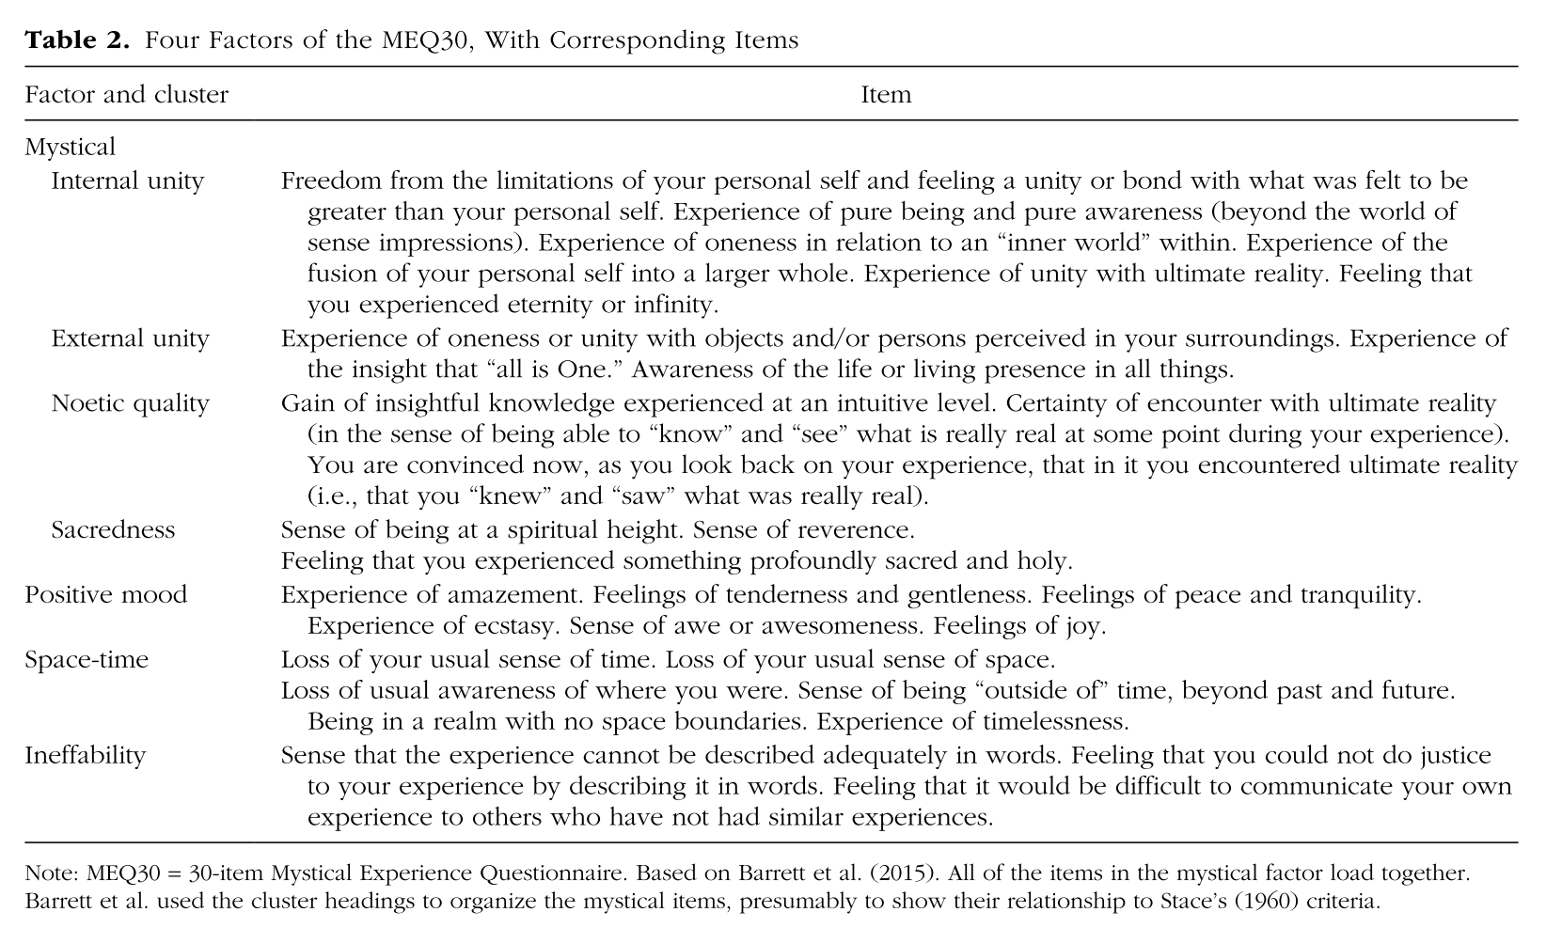
Quantifying the Mystical Experience
From: Mystical and other alterations in sense of self: An expanded framework for studying nonordinary experiences. Taves A, Perspectives on Psychological Science 15:669-690, 2020.

Slide 15
Psychoactive Drug Studies
From: Mystical-type experiences occasioned by psilocybin mediate the attribution of personal meaning and spiritual significance 14 months later, Griffiths RR, Richards WA, Johnson MW, McCann UD, Jesse R, Journal of Psychopharmacology, 22:621–632, 2008.

Slide 16
Neurophysiological Mechanisms
“We have highlighted an intriguing overlap in neural findings on classic hallucinogens and neural findings on meditative practices that may occasion mystical experiences. More specifically, changes in activity, connectivity, and neural oscillatory processes in regions of the default mode network may underlie dimensions of mystical experience, especially decreased self-referential processing and altered sense of time and space that accompany introvertive mystical experiences.”
From: Classic Hallucinogens and Mystical Experiences: Phenomenology and Neural Correlates.
Barrett FS, Griffiths RR, Current Topics in Behavioral Neuroscience 36:393-430, 2018.
https://www.ncbi.nlm.nih.gov/pmc/articles/PMC6707356/pdf/nihms-1044542.pdf
“…these studies collectively suggest the possibility that the pattern and structure of communication between brain networks constitutes the neurobiological basis of consciousness, such that alterations of consciousness are driven by alterations of communication between brain regions.”
From: Classic psychedelics: An integrative review of epidemiology, therapeutics, mystical experience, and brain network function. Johnson MW, Hendricks PS, Barrett FS, Griffiths RR. Pharmacology and Therapeutics, 197:83-102, 2019.

Slide 17
Spirituality
Experience of Contemplative States

Slide 18
Quantum Change
“A common response, when we asked people what had changed, was “everything.”
“…they often reported a sense of settled peacefulness and safety as an immediate and enduring aftereffect.”
“Another major change that quantum changers reported was in their values and priorities…an abrupt and enduring shift in their most central values…“They were no longer possessed by their possessions. Often, characteristics that had been valued least became most important, and those that had ranked as highest priorities fell to the bottom. Spirituality, though not necessarily religion, became central for many.”
From: The phenomenon of quantum change. Miller WR, Journal of Clinical Psychology 60:453-60, 2004.

Slide 19
Yoga as a
Contemplative/Spiritual
Practice

Slide 20
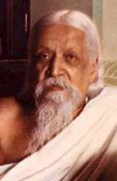
“…a methodised effort towards self-perfection by the expression of the secret potentialities latent in the being … a union of the human individual with the universal and transcendent Existence…”
Sri Aurobindo

Slide 21
Yoga Practices
Postures, Breathing, Relaxation, Meditation
Fitness
↑Flexibility
↑Strength
↑Coordination/Balance
↑Respiratory Function
↑Self-Efficacy
Self-Regulation
↑Stress Regulation
↑Emotion Regulation
↑Resilience
↑Equanimity
↑Self-Efficacy
Awareness
↑Attention
↑Mindfulness
↑Concentration
↑Cognition
↑Meta-cognition
Spirituality
↑Unitive State
↑Transcendence
↑Flow
↑Transformation
↑Life Meaning/Purpose

Slide 22
Temporal Changes in Yoga Practice
Arousal reduction, physical/mental well-being
Mind/body awareness, resilience, self-regulation
Psychological / philosophical transformation

Slide 23
“Yoga changed my life”

Slide 24
Research in Yoga and Spirituality

Slide 25

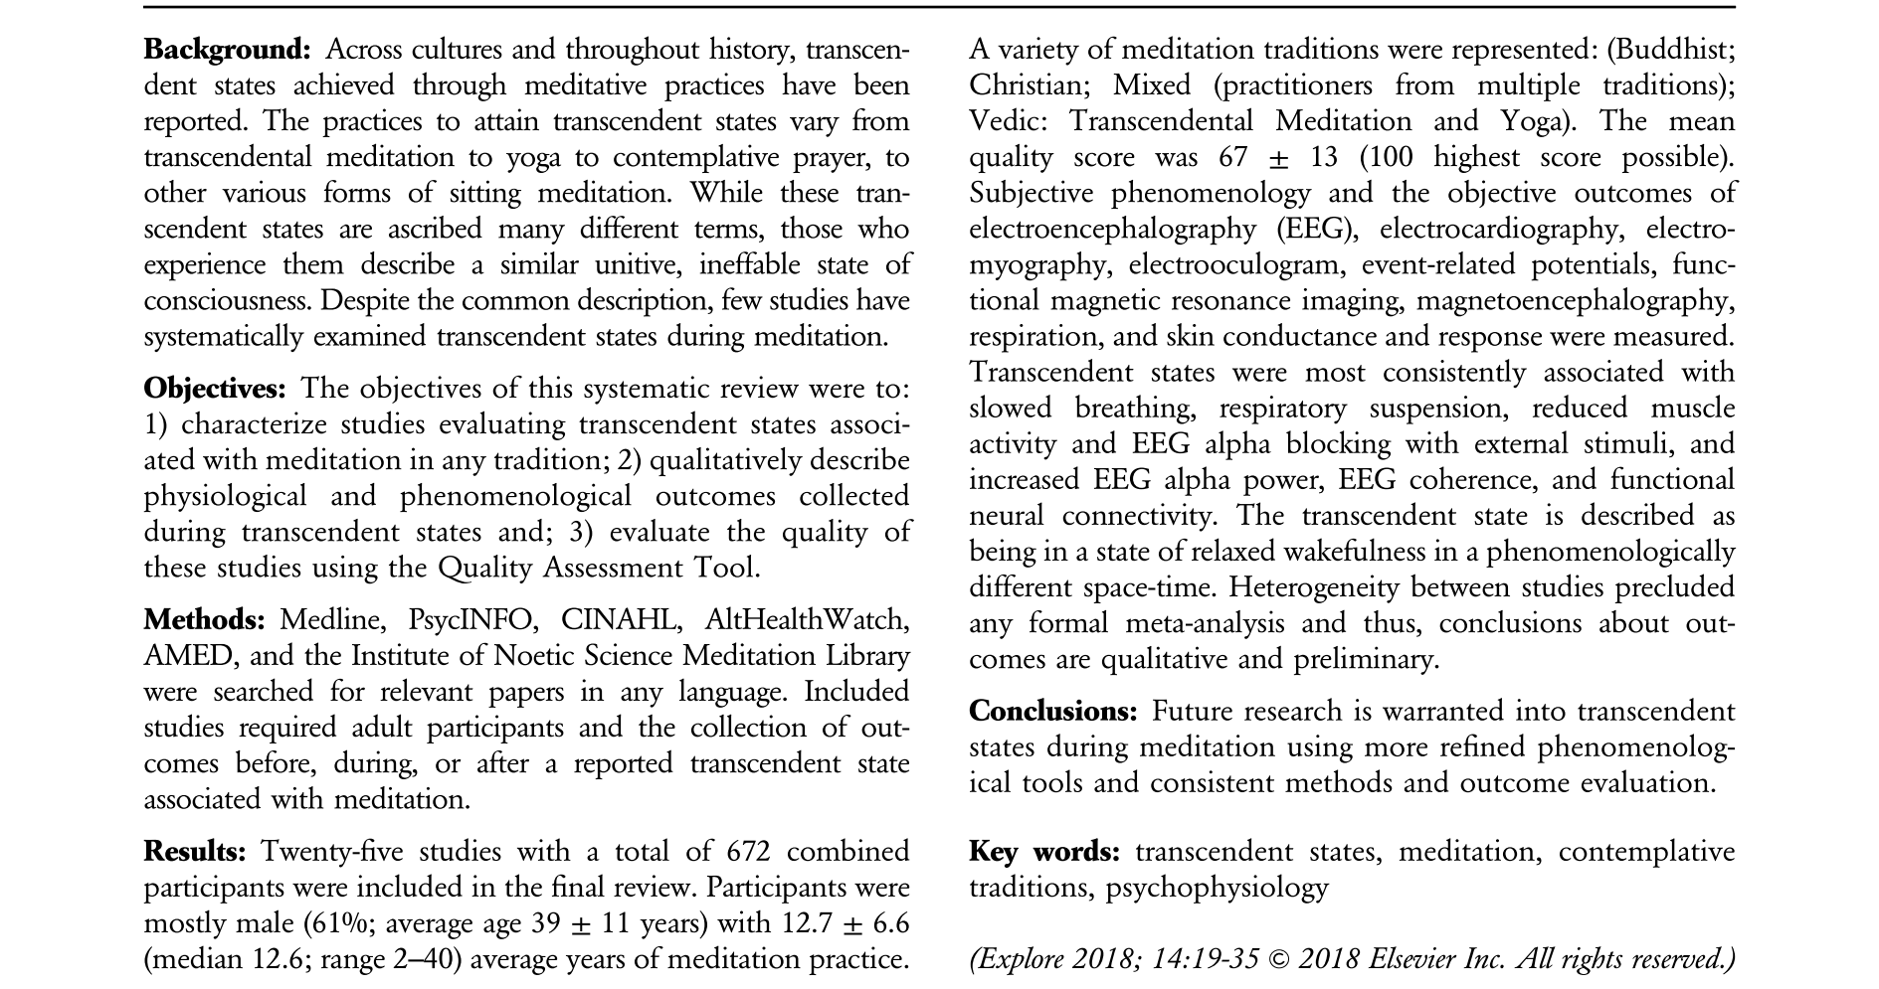

Slide 26
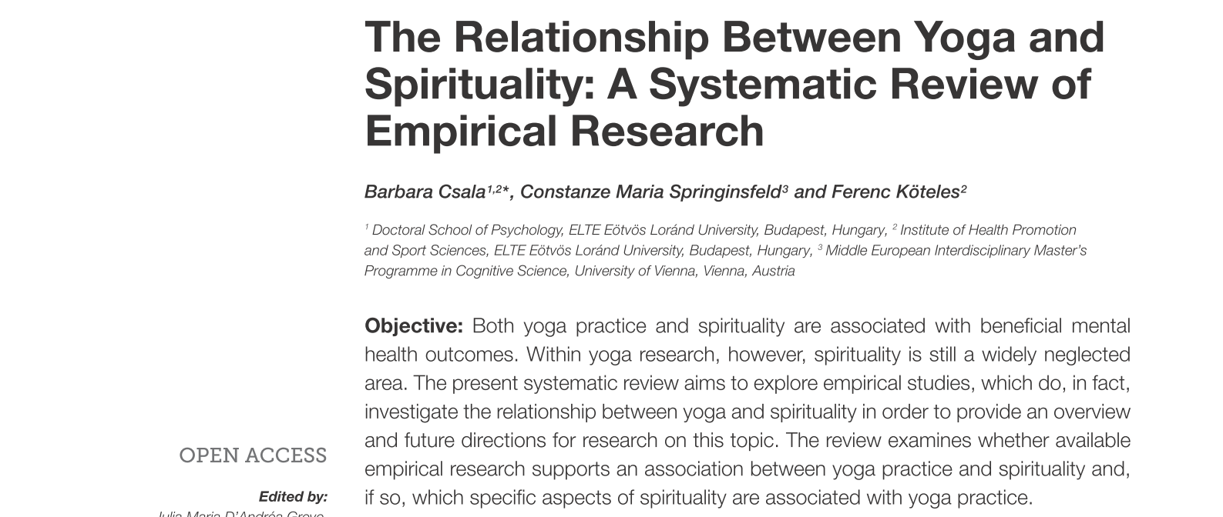
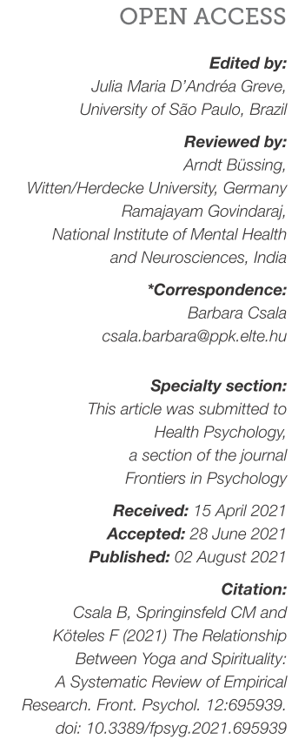
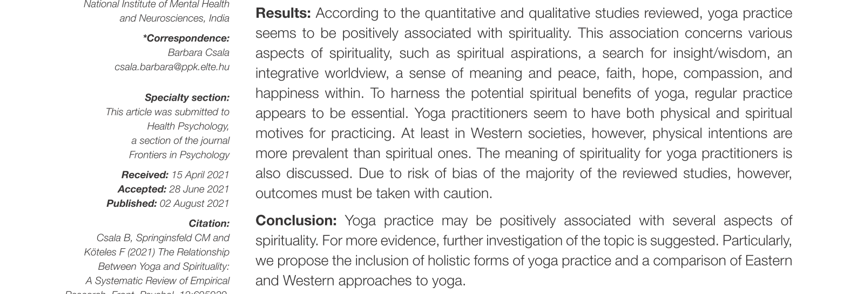

Slide 27

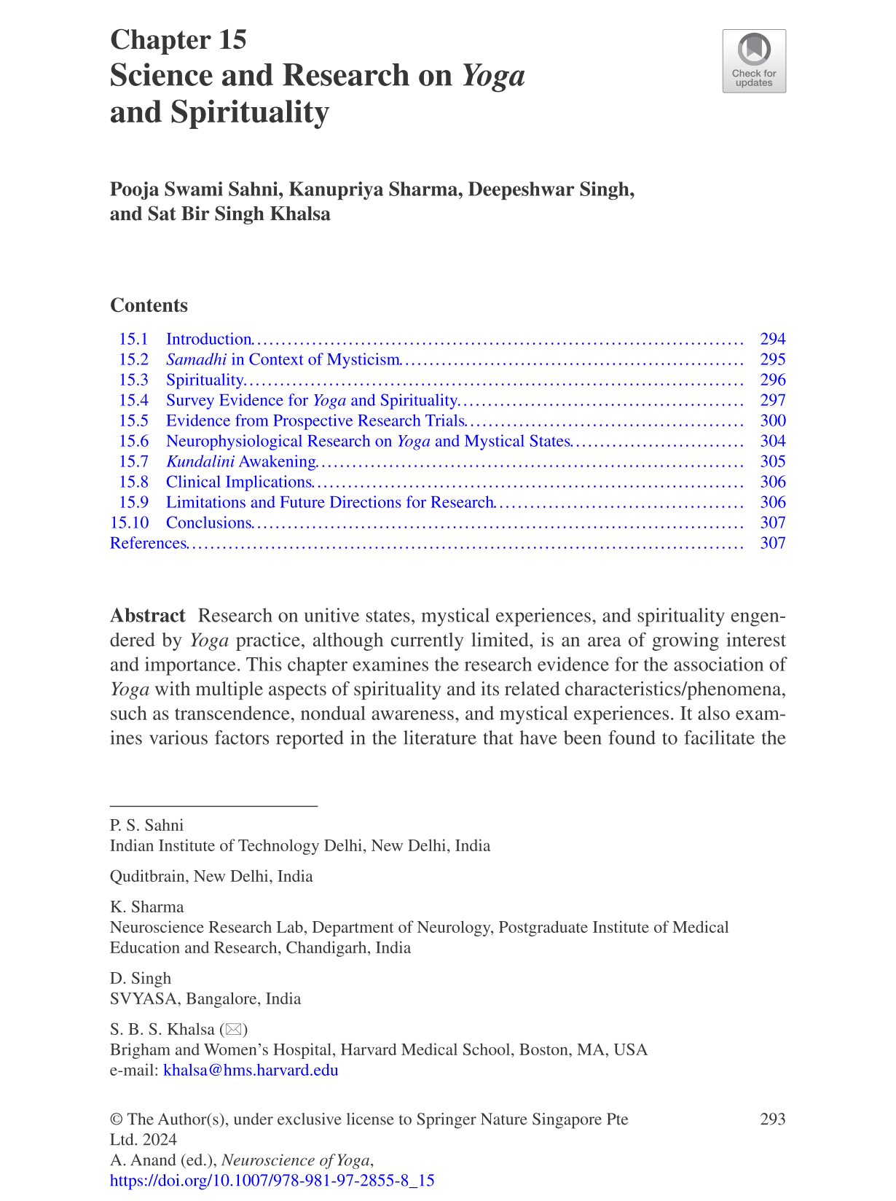

Slide 28
Mystical Experience in Yoga Practitioners
From: Intense personal experiences: Subjective effects, interpretations, and after-effects, Wilson SR, Spencer RC, Journal of Clinical Psychology 46:565-573, 1990.

Slide 29
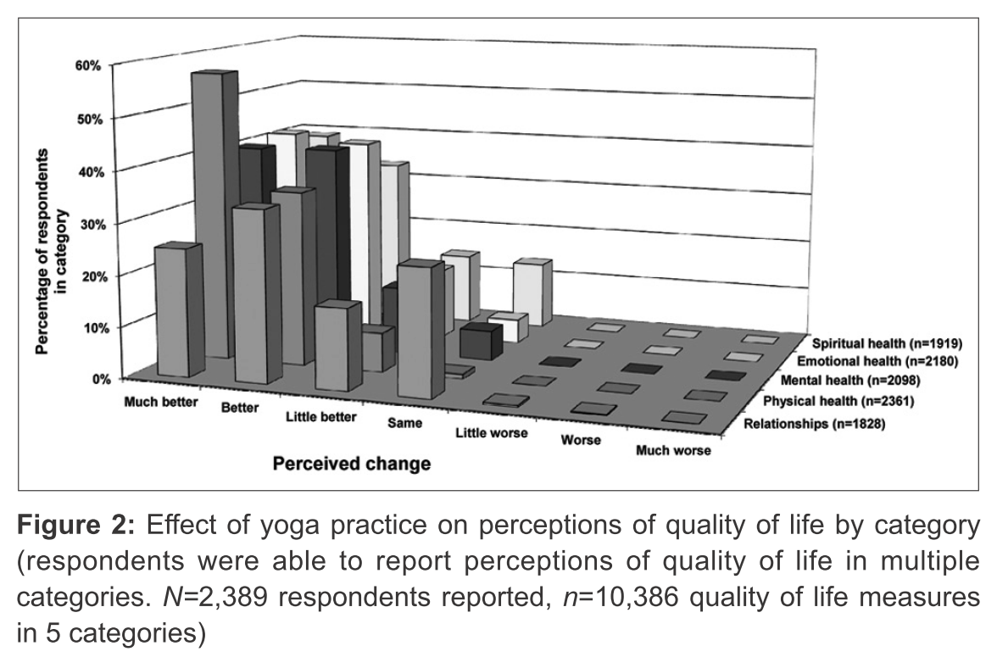
Spirituality as a Perceived Benefit of Yoga
From: Yoga in Australia: Results of a national survey. Penman S, Cohen M, Stevens P, Jackson S, International Journal of Yoga 5:92-101, 2012.
https://www.ncbi.nlm.nih.gov/pmc/articles/PMC3410203/?report=printable

Slide 30
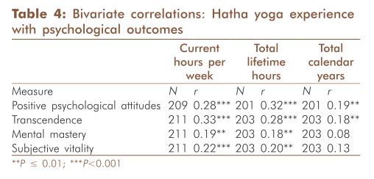
Transcendence in Yoga Practitioners
From: Yoga experience as a predictor of psychological wellness in women over 45 years, Moliver N, Mika E, Chartrand M, Haussmann R, Khalsa S, International Journal of Yoga, 6:11-9, 2013.

Slide 31
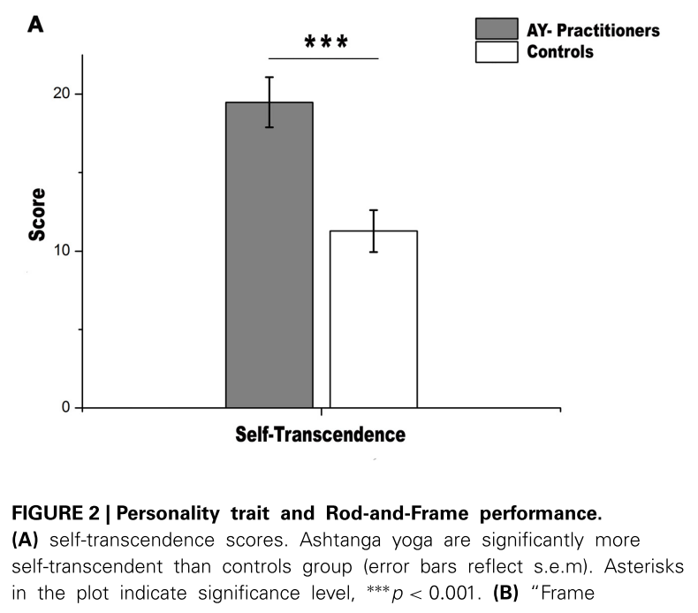
Self-transcendence in Yoga Practitioners
From: Processing of proprioceptive and vestibular body signals and self-transcendence in Ashtanga yoga practitioners, Fiori F, David N, Aglioti SM, Frontiers in Human Neuroscience, 8:734, 2014.
https://www.frontiersin.org/articles/10.3389/fnhum.2014.00734/full

Slide 32
Spirituality in Yoga Practitioners
From: The relationship between yoga involvement, mindfulness & psychological well-being, Gaiswinkler L, Unterrainer HF, Complementary Therapies in Medicine, 26:123-7, 2016.

Slide 33
Yoga in Occupational Setting
From: The effectiveness of yoga for the improvement of well-being and resilience to stress in the workplace. Hartfiel N, Havenhand J, Khalsa SB, Clarke G, Krayer A. Scandinavian Journal of Work, Environment and Health, 37:70-6, 2011.

Slide 34
6-Month Intensive Yoga Practice
From: Development of Specific Aspects of Spirituality during a 6-Month Intensive Yoga Practice. Büssing A, Hedtstück A, Khalsa SB, Ostermann T, Heusser P. Evidence Based Complementary and Alternative Medicine. 2012:981523, 2012.
https://onlinelibrary.wiley.com/doi/epdf/10.1155/2012/981523

Slide 35
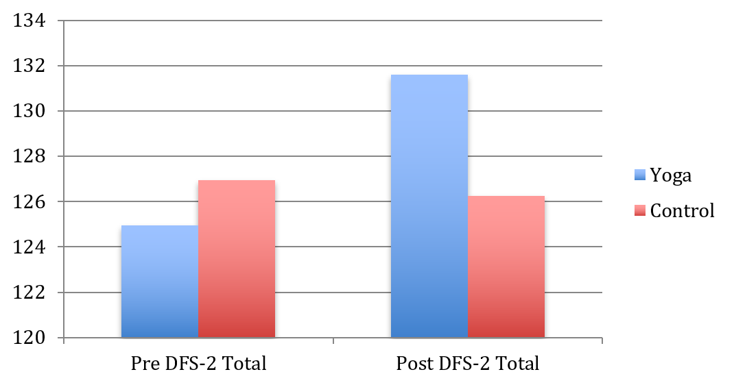
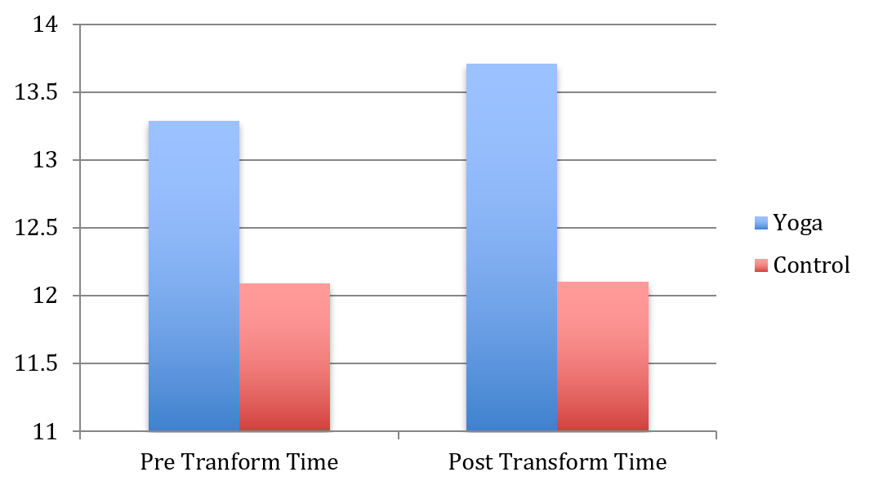
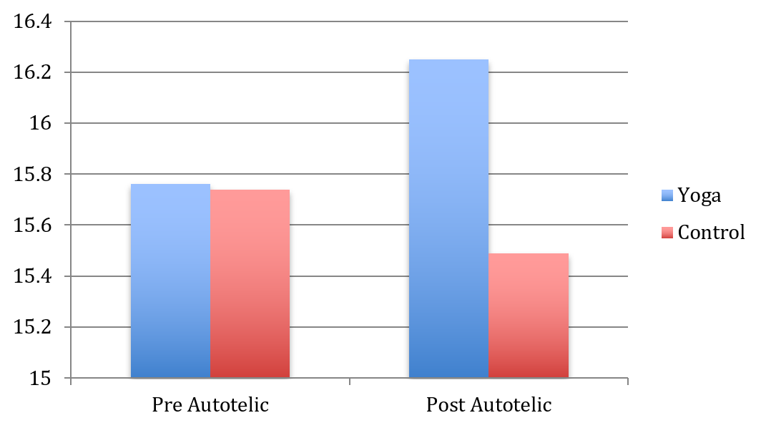
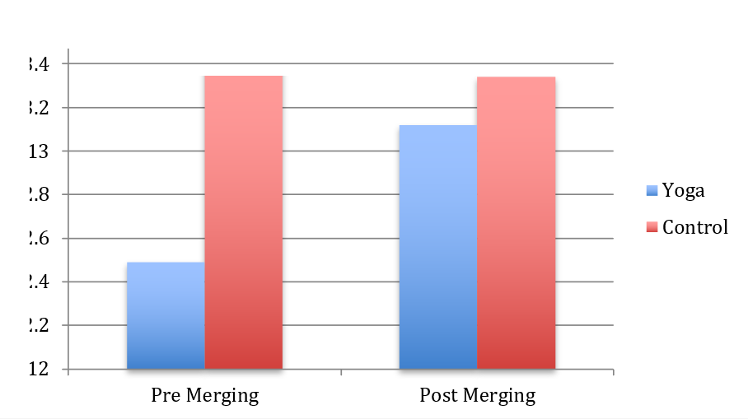
Dispositional Flow Scale Total
p < 0.05
Increase in Flow State in Musicians after Kripalu Yoga
Time
Autotelic
Merging
p = 0.05
13.4
13.2
13.0
12.8
12.6
12.4
12.2
12.0
p = 0.08
From: Yoga Enhances Positive Psychological States in Young Adult Musicians, Butzer B, Ahmed K, Khalsa SB, Applied Psychophysiology and Biofeedback, 41:191-202, 2016.

Slide 36
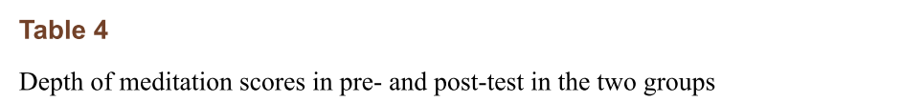
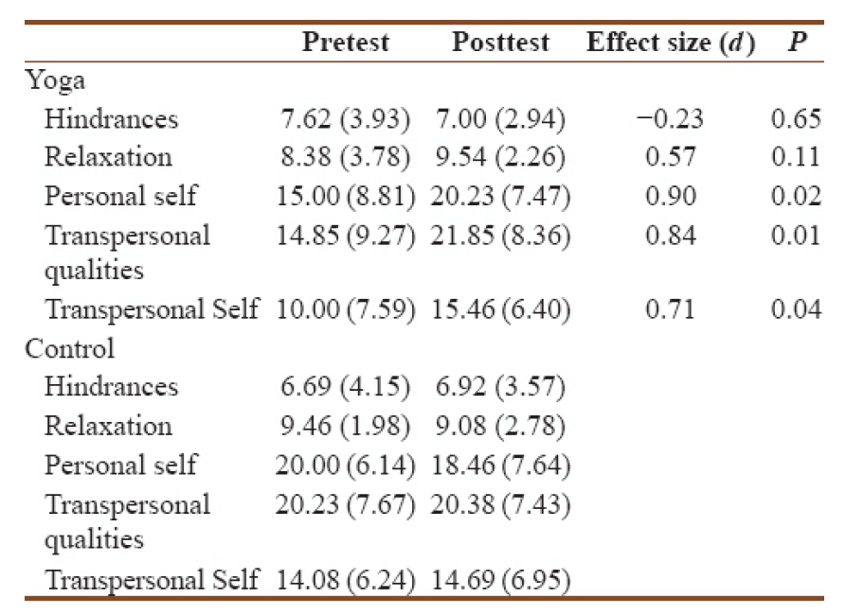
Asanas Facilitating Transpersonal Change in Meditators
From: Effects of Maharishi Yoga Asanas on Mood States, Happiness, and Experiences during Meditation. Gobec S, Travis F, International Journal of Yoga, 11:66-71, 2018.
https://www.ncbi.nlm.nih.gov/pmc/articles/PMC5769201/?report=printable

Slide 37
Qualitative Experiences of Spirituality with Yoga
“This has been a life changing, grounding experience.”
“I have noticed a positive shift in my entire life.”
“Renewed sense of purpose. Increased appreciation for life, stillness, mindfulness and nature...Life changing.”
From: RISE program study qualitative interviews, unpublished data.
“With yoga, I had a connection of mind, body, and spirit. During the practice and when you become aware of those three things, or be aware of them, it seems like things are more possible. I had more peace, the idea of ﬁnding increased peace of mind. I mean what could be richer than a sense of you know a spirit; my spiritual self.’’
From: A Yoga Intervention Program for Patients Suffering from Symptoms of Posttraumatic Stress Disorder: A Qualitative Descriptive Study. Jindani FA, Khalsa GF, Journal of Alternative and Complementary Medicine 21:401-8, 2015.

Slide 38
Spirituality as a Motive for Practicing Yoga
Crystal L. Park
University of Connecticut

Slide 39


How salient is spirituality among motivations for starting to practice yoga? What are initial motives for practice?
.

Slide 40
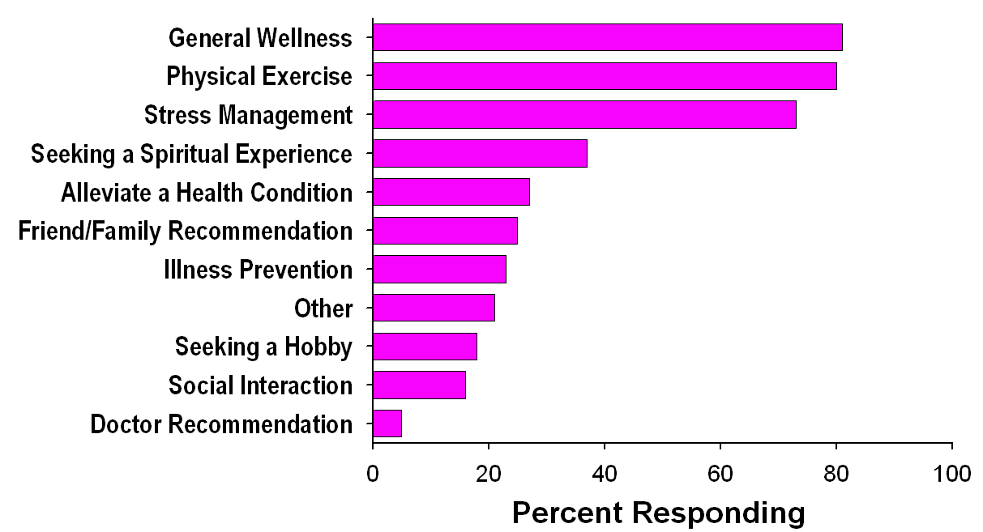
Reasons for Practice in a Beginners Program
Quilty, M. T., Saper, R. B., Goldstein, R., & Khalsa, S. B. S. (2013). Yoga in the real world: Perceptions, motivators, barriers, and patterns of use. Global Advances in Health & Medicine, 2, 44-49.

Slide 41
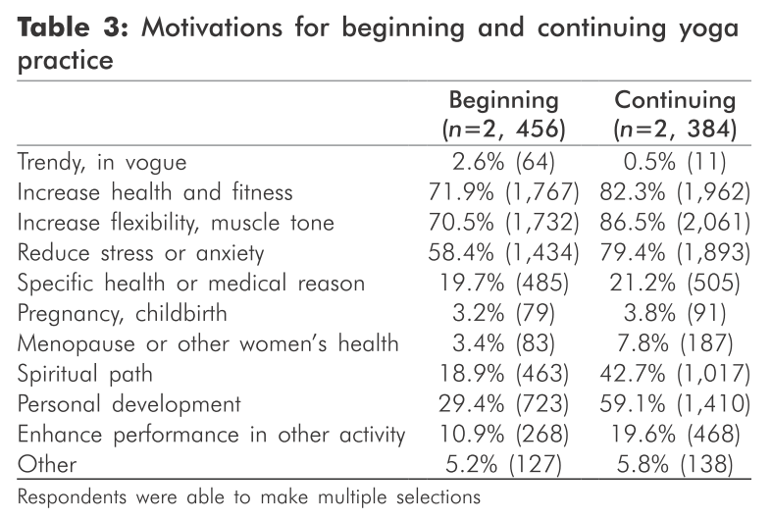
Reasons for Practice
Penman S, Cohen M, Stevens P, & Jackson S. (2012).
Yoga in Australia: Results of a national survey. International Journal of Yoga 5, 92-101.

Slide 42
Park, C. L., Riley, K. E., Bedesin, E., & Stewart, V. M. (2016). Why practice yoga? Practitioners’ motivations for adopting and maintaining yoga practice. Journal of Health Psychology, 21(6), 887-896.
Snowball sample of 512 participants from across the US (156 teachers)
Mostly female (93.4%), Caucasian (94%), and well educated
Aged 18 to 85 years (M = 45.78, SD = 14.04)
Students practiced a mean of 245 min/week in a yoga studio and a mean of 85 min/week at home, and reported they had been practicing yoga for a mean of 8.5 years (SD = 7.67 years)
Teachers practiced an average of 374 min/week in a yoga studio and 168 min/week at home, and reported that they had been practicing yoga for a mean of 13 years (SD = 9.26 years)

Slide 43
Motivations for starting to practice yoga

Slide 44
The majority changed their motivation for practicing yoga or discovered new aspects
61.3% reported yes, they had changed their primary reason for doing yoga or discovered other aspects
38.6% reported no, they had not

Slide 45
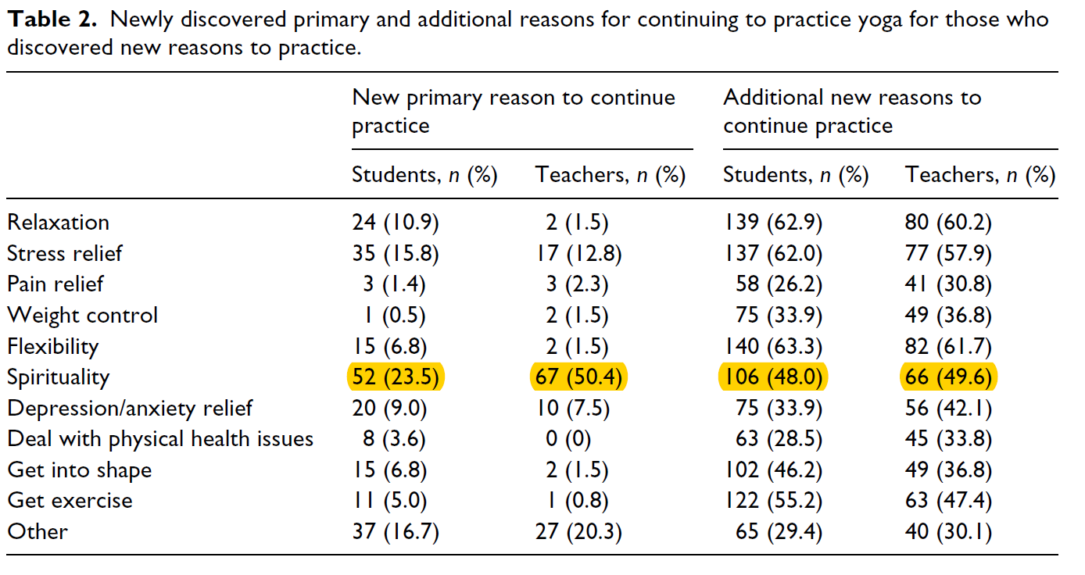
New primary and additional reasons to practice yoga

Slide 46
Park, C. L., Quinker, D., Dobos, G., & Cramer, H. (2019). Motivations for adopting and maintaining a yoga practice: A national cross-sectional survey. The Journal of Alternative and Complementary Medicine, 25(10), 1009-1014.
Snowball sample of 1702 participants from across Germany
The most common primary reasons for starting yoga were relaxation (26.6%) and prevention (25.5%), which were also the most common secondary reasons
55.3% reported a different primary reason for maintaining than for adopting yoga practice
Prevention (38.4%) and spirituality (26.4%) were the most commonly reported primary reasons for maintaining yoga practice

Slide 47
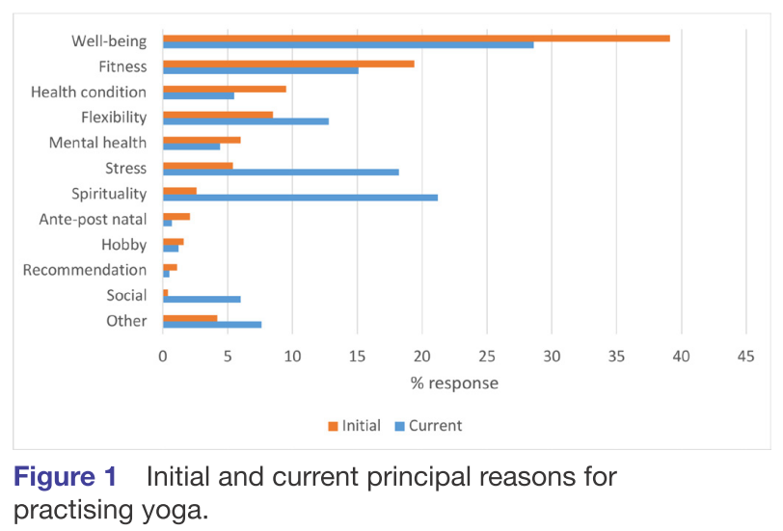
Reasons for Practice
Cartwright, T., Mason, H., Porter, A., & Pilkington, K, (2020). Yoga practice in the UK: A cross-sectional survey
of motivation, health benefits and behaviours. BMJ Open, 12;10(1):e031848.

Slide 48
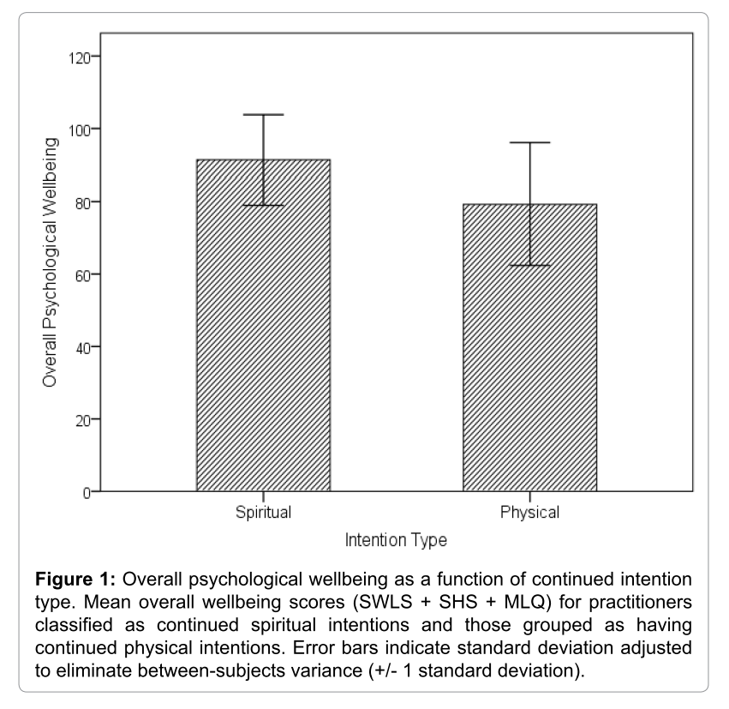
Reasons for Practice
“…practitioners had greater initial and continued physical intentions than spiritual intentions. However, spiritual intentions become more salient over time, suggesting that Western yoga can cultivate spirituality. Results also showed that practitioners with spiritual intentions reported significantly higher psychological wellbeing.”
Gaiswinkler, L., & Unterrainer, H. F. (2016). The relationship between yoga involvement, mindfulness & psychological well-being, Complementary Therapies in Medicine, 26,123-127.

Slide 49
Ahmadi, S. E., Park, C. L., & Carney, L. (in progress). Does taking yoga “off the mat” moderate associations of practice with coping, stress, and distress?
Snowball sample of 341 participants in the US
Participants were 81.1% White, 3.2% Asian, 2.7% multiracial, 1.7% Black or African American, and 11.3% unknown or preferred not to disclose
Participants were majority not Latino or Hispanic (88.0%) and female (84.8%)
Average age was 40.8 years (SD = 15.7)
Participants had practiced yoga for an average of 1051 minutes (SD = 909.1) in the past month(or an average of 35 minutes per day)

Slide 50
Top reason for starting a yoga practice
23.3% stress management/relaxation
3.9% spirituality

Slide 51
52.8% changed to a new top reason for continuing yoga practice
23.7% spirituality

Slide 52
Correlates of length of time practicing yoga
To what extent do you consider yourself a religious person? r = -.09 (ns)
Frequency of religious service attendance r = .01 (ns)
To what extent do you consider yourself a spiritual person? r = .16**
Sleep quality r = .19***
Depression/anxiety/stress r = .21***
Self-rated overall health r = .21***

Slide 53

Contact me: crystal.park@uconn.edu

Slide 54

Yoga in Cancer Care:
Taking Yoga Beyond the Mat
Lorenzo Cohen, PhD
Richard E Hayes Distinguished Professorship for
Clinical Cancer Prevention
Director, Integrative Medicine Program
MD Anderson Cancer Center
Notes:
Thank you for taking your valuable time to spend it with us.
Let’s come together for a moment of centering. While we are not in person - we can still join together.
Settle into this moment together
Honor the time you have carved out to be here or to watch this later.
Three deep centering breaths
Take 3 deep diaphragmic breaths
I will lead it
Inhale and exhale through the nose
Longer exhale than inhale
Notice how with each inhale you are able to get the air deeper into the body
Close eyes – sit up straight
MDACC /Coach – Educator
Science (explained in a clear and easy to understand manner)
Elements of coaching
Educational elements
Ideas to where to start - with what – you know what is best so start by turning these ideas over and keeping in mind while some might not work for you maybe you are ready to try something you would never have considered a year ago
Pose questions throughout - respond in the Chat if comfortable
Our goal is for each of you to create a body/mind/soul that is inhospitable to cancer. We hope it will Empowering and hopeful
Family affair -
Get educated on the evidence
Our story

Slide 55







Cancer Prevention and Control:
The Mix of Six
Social Support
Stress Management
Sleep
Physical Activity
Diet
Environmental Toxins
Notes:
MOS – support cancer treatment – reduce the body’s need to be fixing and spending energy elsewhere – straining - Specific order
Important to understand a little in each area both the science and what change could look like
Important to view your health as a whole not one silo or another
Takes pressure off specific areas to know that it is made up of multiple areas
slide in one area you have the opportunity to focus in another that still impacts your health in a positive way
It is a series of small steps across multiple areas as your focus allows for it.
Evidence based – You can feel confident that what is shared today is backed by science.
Go through MOS - we are going to ask you to write down something you that is a start – something that is right for you and your family
Best expert on yourself – you know what is and is not going to work – what fits with your living environment
If you like an idea but you are not sure write it down and see if there is a first step that could take you in the direction you are interested in moving

Slide 56
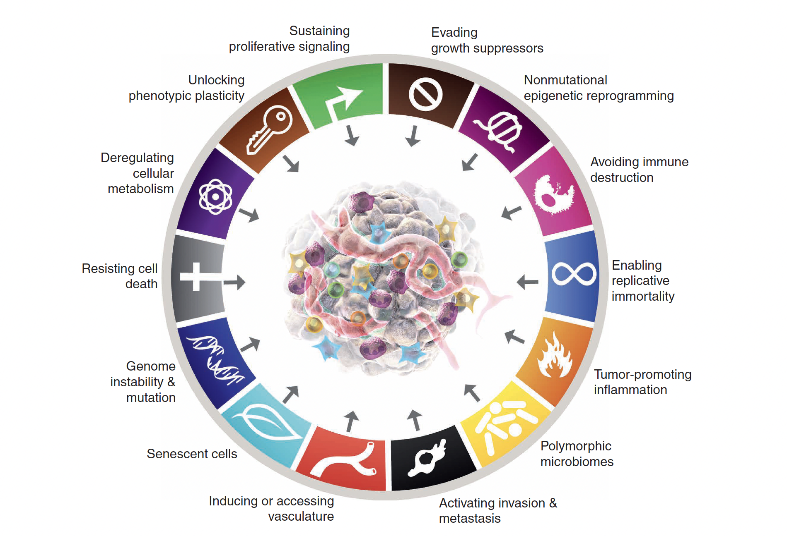
Hannahan, Cancer Discovery 2022

Slide 57


Synergy
Yoga with a Capital “Y”
A phenomena where the whole is more than the sum of the parts
Notes:
The question to ask is: Are you experiencing positive or negative synergy? For most of us it is all too easy to relate to negative synergy!
Sleep poorly – skip exercising – crave high carb foods – short with those around you – cognitively less able
What you feel and recognize on outside is an alert that your cells are changing and stressed on the inside.
How do you create positive synergy the majority of the time? How do you set yourself up for success and create positive contagion?
The MOS is a comprehensive approach because it is yours to individualize. It is dynamic, fluid and unique just like you.
Never too late or too early to adopt anticancer living. If you have a cancer diagnosis support your treatment by creating this body that will be inhospitable to cancer. Nella Bea, an inspiring woman in our book said I don’t want to give cancer any more of a chance to develop that it already has. I can do things that I know will help
Feel shame, blame, guilt

Slide 58
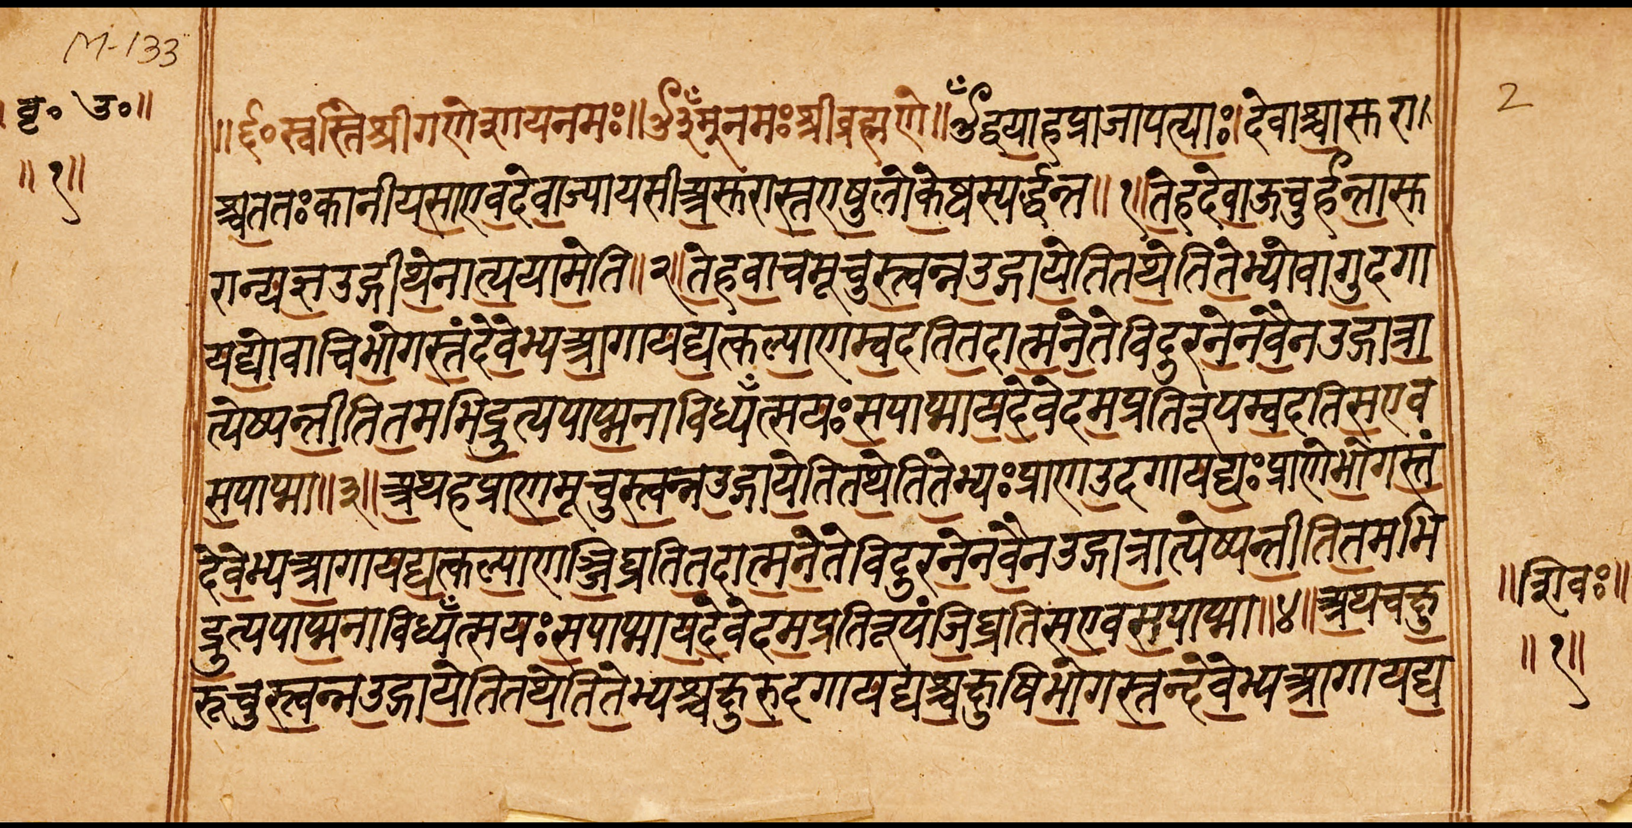
DEFINITION OF YOGA
YUJYATE ANENA ITI YOGAH
  JOINING INDIVIDUAL SOUL TO UNIVERSAL SOUL Classical
TAM YOGAM ITI MANYANTE STIRAM INNDRIYA DHARANAM
  YOGA IS HOLDING THE SENSES STEADY Upanishad
MANH PRASAMANA UPAYAH YOGAH
  A TECHNIQUE TO MAKE THE MIND QUIET Yoga Vasista
SAMATVAM YOGA UCCHYATE
  YOGA IS A STATE OF EQUANIMITY Bhagavad-Gita
Courtesy of NV Raghuram

Slide 59
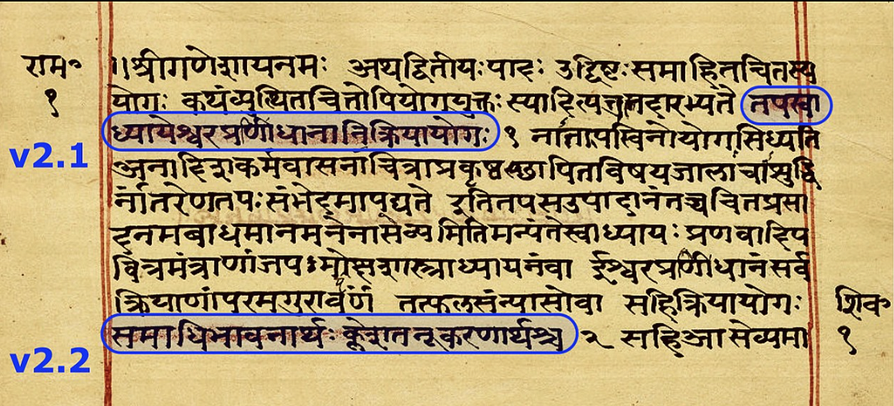
DEFINITION OF YOGA
YOGAH CITTA VRITTI NIRODHAH
  YOGA IS CONTROLLING THE DISTURBANCES OF THE MIND Patanjali Yoga Sutras
Courtesy of NV Raghuram

Slide 60
Yoga with a Capital “Y”
Social Support
Stress Management
Sleep
Physical Activity
Diet
Environmental Toxins
Notes:
MOS – support cancer treatment – reduce the body’s need to be fixing and spending energy elsewhere – straining - Specific order
Important to understand a little in each area both the science and what change could look like
Important to view your health as a whole not one silo or another
Takes pressure off specific areas to know that it is made up of multiple areas
slide in one area you have the opportunity to focus in another that still impacts your health in a positive way
It is a series of small steps across multiple areas as your focus allows for it.
Evidence based – You can feel confident that what is shared today is backed by science.
Go through MOS - we are going to ask you to write down something you that is a start – something that is right for you and your family
Best expert on yourself – you know what is and is not going to work – what fits with your living environment
If you like an idea but you are not sure write it down and see if there is a first step that could take you in the direction you are interested in moving

Slide 61



Slide 62
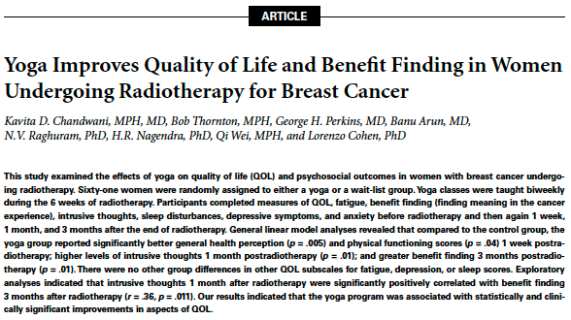
Chandwani……..Cohen, JSIO, 2010

Slide 63
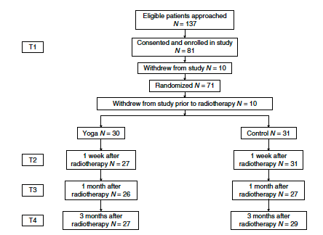
Chandwani……..Cohen, JSIO, 2010

Slide 64
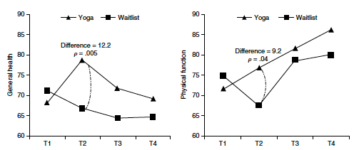
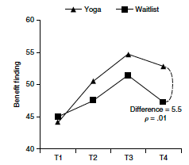
SF-36 and Benefit Finding
Chandwani et al., JSIO, 2010

Slide 65
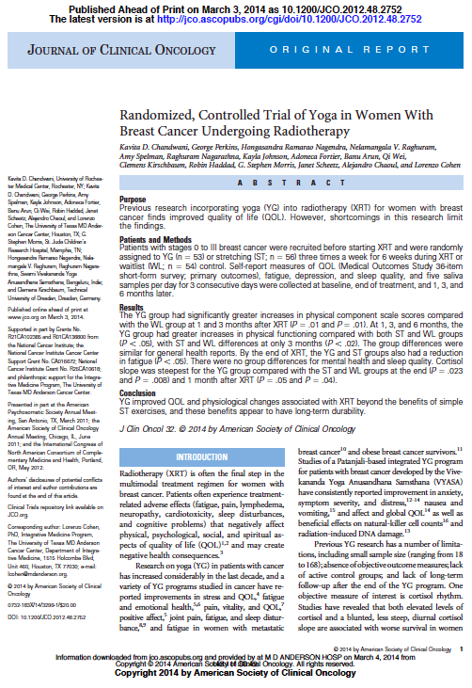

Slide 66


Eligible patients approached
N=294
Participant Flow
Consented and enrolled in study
n=191
Dropped or taken off study n=13
Randomized n=178
Dropped or taken off study prior to radiotherapy n=15
Yoga n=53
Stretch n=56
Control n=54
End of treatment n=49
End of treatment n=53
End of treatment n=49
1 month after radiotherapy n=39
1 month after radiotherapy n=45
1 month after radiotherapy n=43
3 months after radiotherapy n=41
3 months after radiotherapy n=41
3 months after radiotherapy n=42
6 months after radiotherapy n=43
6 months after radiotherapy n=43
6 months after radiotherapy n=46
Chandwani et al., JCO, 2014
Notes:
66

Slide 67
SF-36 Physical Functioning
*
*
*
*
End of Treatment
1 month follow-up
3 month follow-up
6 month follow-up
End of Treatment
1 month follow-up
P<0.0001
p=0.0002
p<0.02
Chandwani et al., JCO, 2014
Notes:
SF-36 general health scores increased more in the YG group than STR and WLC at 1 and 3 months (p-values<.02), with no differences between the STR and WLC (1 month: 3.5, -1.5, -0.5; 3 months: 4.1, 0.1, -1.1).
At 1, 3, and 6 months after treatment, the YG group had greater increases in SF-36 physical functioning compared to both STR and WLC (1 month: 5.8, 2.0, 0.8; 3 months: 6.5, 3.4, -0.2; 6 months: 6.1, 3.4, 1.1; p-values<.05), with differences between STR and WLC at 3 months (p<.02).

Slide 68
SF-36 General Health
*
*
End of Treatment
1 month follow-up
3 month follow-up
6 month follow-up
Chandwani et al., JCO, 2014
p=0.011
p=0.005
Notes:
Label axes!
At 1, 3, and 6 months after treatment, the YG group had greater increases in SF-36 physical functioning compared to both STR and WLC (1 month: 5.8, 2.0, 0.8; 3 months: 6.5, 3.4, -0.2; 6 months: 6.1, 3.4, 1.1; p-values<.05), with differences between STR and WLC at 3 months (p<.02).

Slide 69
Cortisol
Waking 45 minutes 8 hours 12 hours Bedtime
Chandwani et al., JCO, 2014

Slide 70
Cortisol
Waking 45 minutes 8 hours 12 hours Bedtime
Chandwani et al., JCO, 2014
p=0.01
Notes:
Where is 6 months?
By 3 and 6 months, there were significant increases in BF for the YG group with decreases in the other two groups (3 months: 3.1, -2.5, -2.5; 6 months: 1.1; -3.9; -4.7; p-values<.05).
70

Slide 71
Benefit Finding
*
*
End of Treatment
1 month follow-up
3 month follow-up
6 month follow-up
Chandwani et al., JCO, 2014
p=0.026
p<0.039
Notes:
Where is 6 months?
By 3 and 6 months, there were significant increases in BF for the YG group with decreases in the other two groups (3 months: 3.1, -2.5, -2.5; 6 months: 1.1; -3.9; -4.7; p-values<.05).

Slide 72
Mean change from baseline

Slide 73
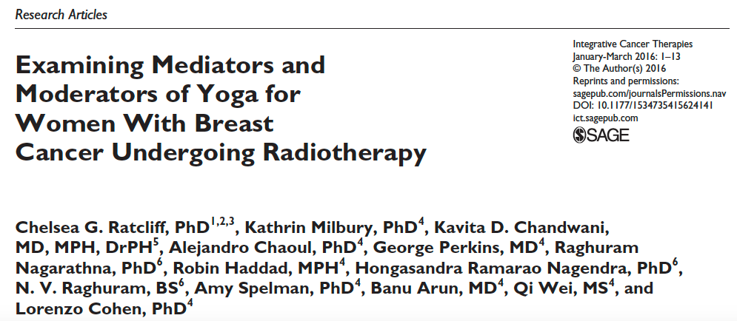
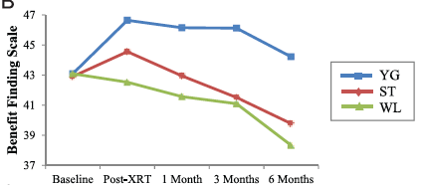

Slide 74
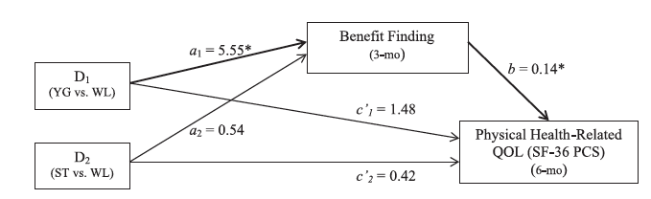
Ratcliff et al., ICT, 2016
Notes:
Yoga indirectly affects physical health–related QOL (SF-36 PCS) at the 6-month follow-up via increased benefit finding (BFS) at 3 months. Values on each path are unstandardized path coefficients taken from bootstrapping analyses controlling for age, stage of disease, time since diagnosis, type of surgery, chemotherapy type, and baseline benefit finding (BFS), physical health–related QOL (SF-36 PCS), and the SF-36 general health subscale. The a1 and a2 paths correspond to the mean differences in 3-month BFS between YG relative to WL and ST relative to WL, respectively. Thus, YG resulted in 3-month BFS scores that were a1 = 5.55 units higher than WL (P = .04), and ST resulted in BFS that were a2 = 0.54 points higher than WL (P = .84). The b pathway corresponds to the relation between 3-month BFS and 6-month SF-36 PCS when group is held constant. Thus, for every 1 point increase in 3-month BFS, individuals reported an average b = 0.14-point increase in 6 month SF-36 PCS (P = .04). The relative indirect effects of group can be determined by multiplying the a and b paths. Thus, relative to WL, YG resulted in SF-36 PCS scores that were a1b = 0.77 units higher as a result of the positive effect of YG on BFS, which corresponds to a significant indirect effect of YG versus WL on 6-month SF-36 PCS via 3-month BFS (B = 0.77; SE = 0.58; 95% bias-corrected and accelerated [BCa] CI = 0.01 and 2.58). Conversely, there was no significant indirect effect of ST versus WL on 6-month SF-36 PCS via 3-month BFS (B = 0.07; SE = 0.43; BCa CI = −0.84 and 0.88).

Slide 75
Yoga with a Capital “Y”

Slide 76
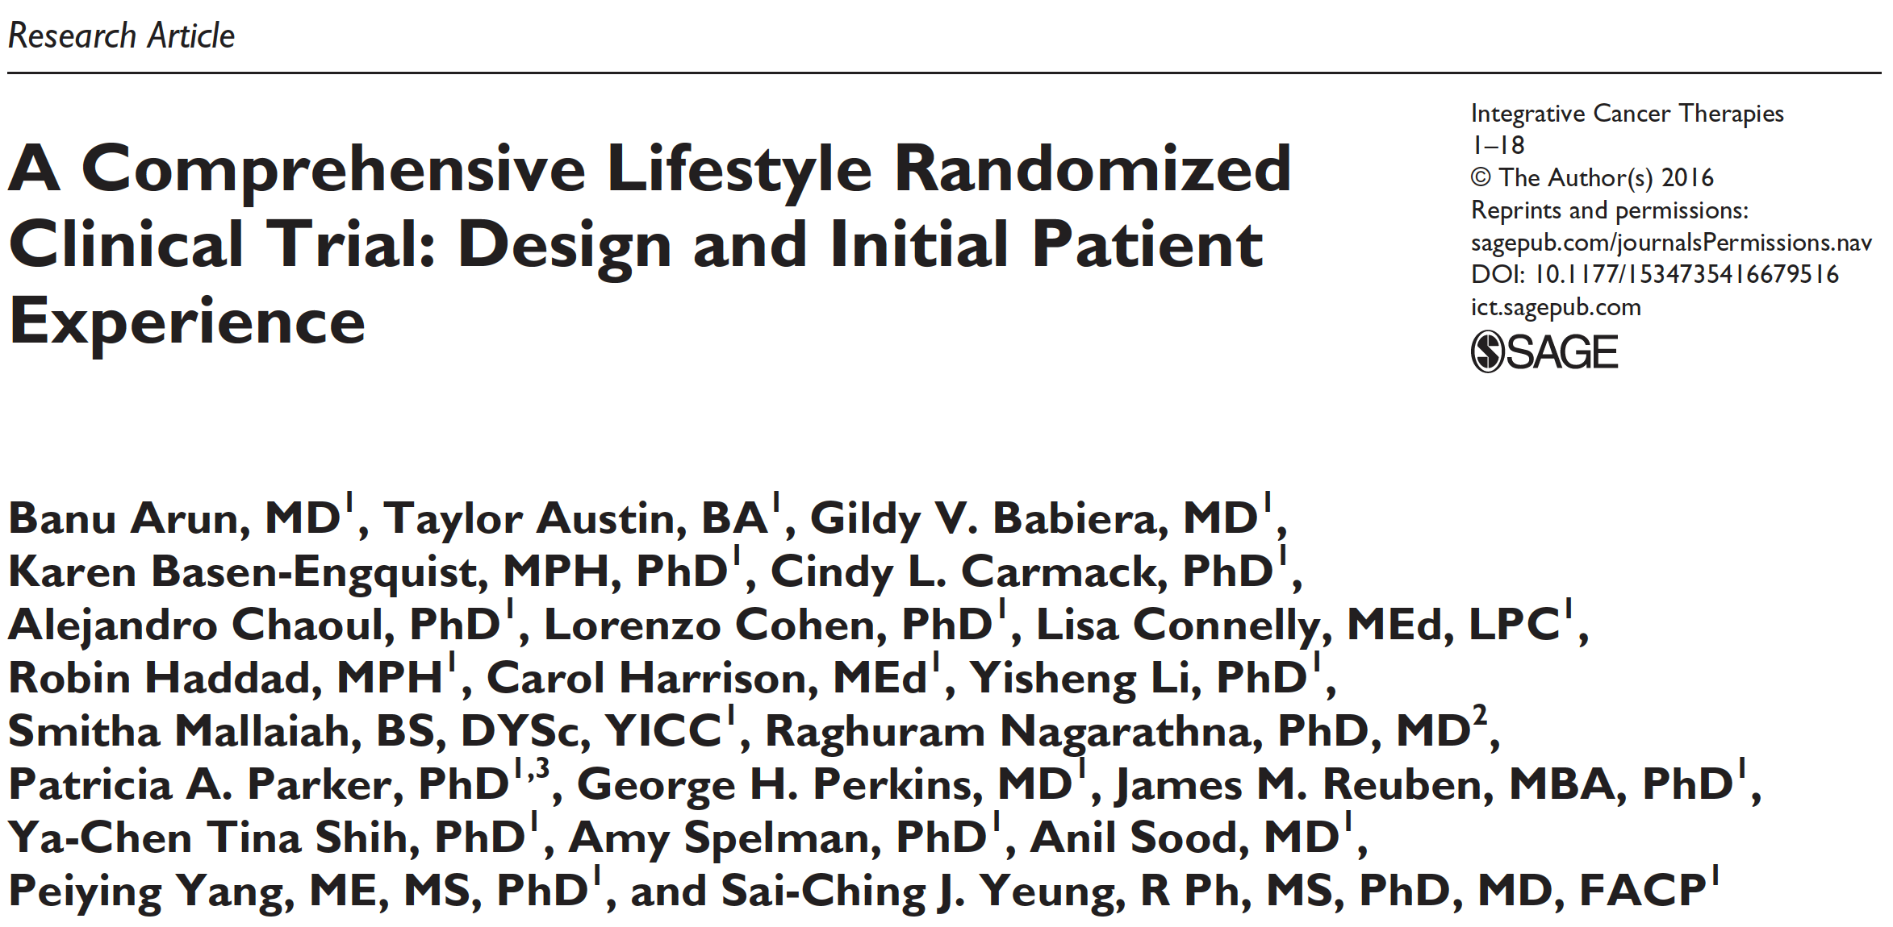

Slide 77

“Through meditation and deep relaxation my answers are flowing”
Notes:
A strong statement of the more profound changes that are taking place comes from the following patient quote: “I don't know if anyone has ever felt like this. To have so many questions, but the answers are trapped in you. That's how I've felt for so long. Well, I've come to realize that through meditation and deep relaxation that my answers are flowing. I can honestly say that I've never been in such deep thought about my life”.

Slide 78

Notes:
78

Slide 79
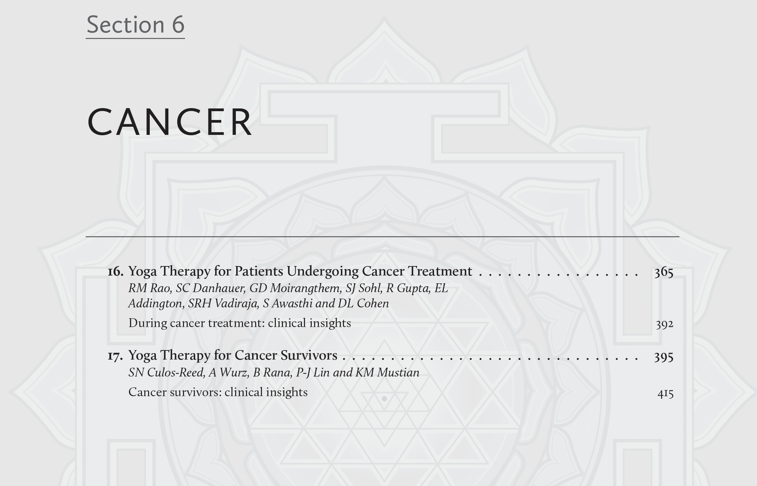

Slide 80
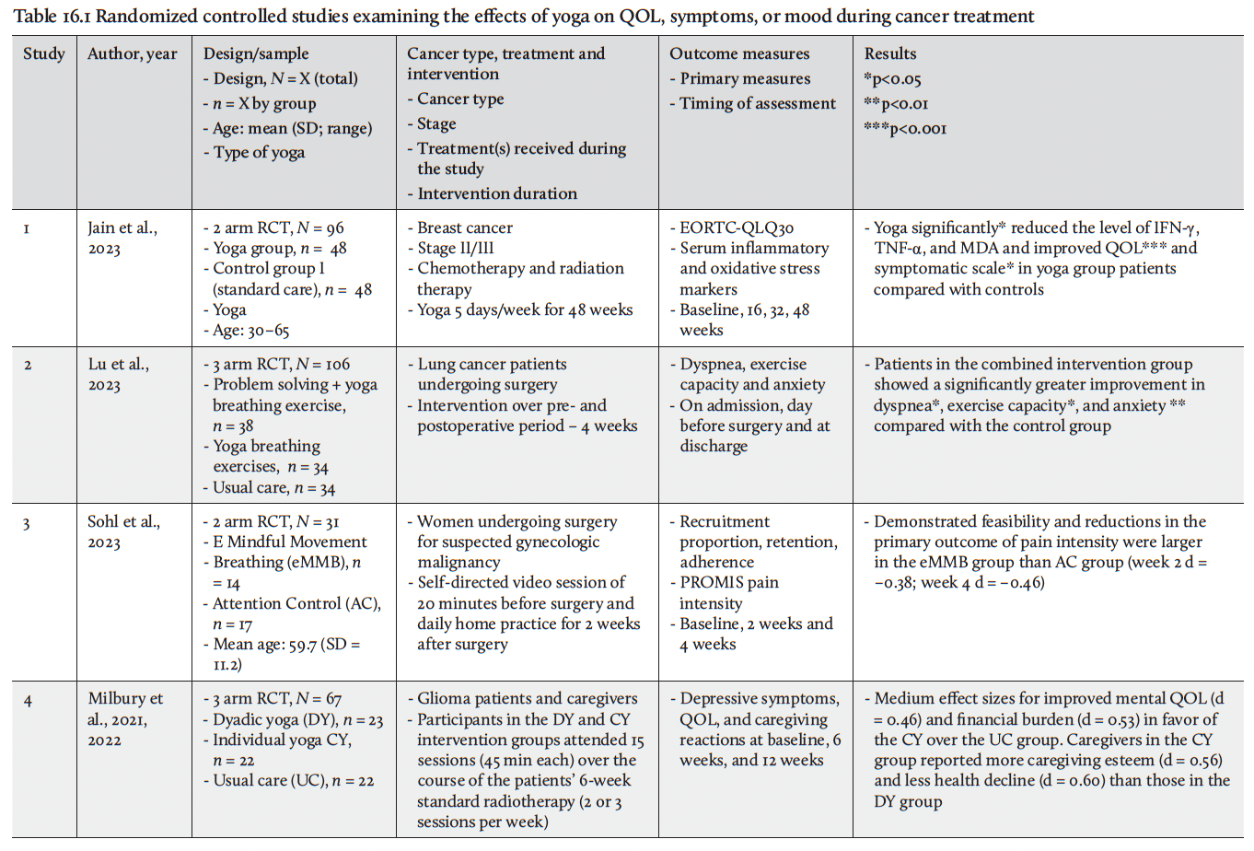

Slide 81

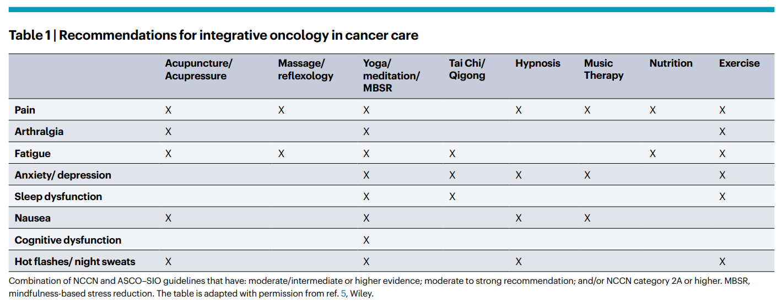

2024

Slide 82

“Humans on every part of the planet have found ways to focus inward on oneself, on one’s connection to others, to a higher power, and to the world as a whole.”
Cohen & Jefferies: Anticancer Living: Transform Your Life and Health With the Mix of Six
Notes:
Humans on every part of the planet have found ways to focus inward on oneself, on one’s connection to others, to a higher power, and to the world as a whole. Engaging in a mind-body practice is a time to seek calm, when we can slow down and bring awareness to the moment. Fostering and expanding one’s spirituality and life purpose is an important aspect for achieving optimal health and well-being. People can modify the practices to meet their own individual needs and to ensure that they remain aligned with their own religious practices. Indeed, we work through these issues often with our own patients. For example, one of the CompLife patients with a deep Christian practice had some initial concerns of whether the yoga and meditation would conflict with her practices and beliefs. In fact, the opposite occurred. By making subtle modification in the language used in the yoga and meditation, the patient expressed later that she had never felt closer to her God than in the mind-body sessions.

Slide 83
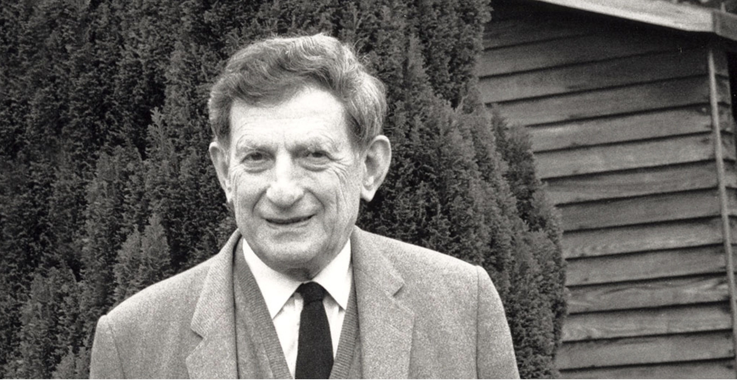
Deep down the consciousness of mankind is one. This is a virtual certainty because even in the vacuum matter is one; and if we don't see this, it's because we are blinding ourselves to it.
- David Bohm
Photo: Mark Edwards

Slide 84
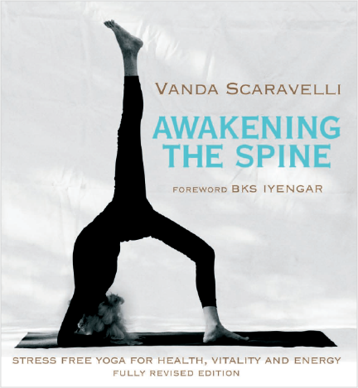
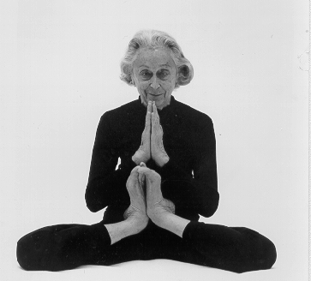
Yoga with a Capital “Y”
“Yoga…it is a living process that changes moment by moment. Watching when we eat - how we eat; when we walk - how we walk; what we say - how we say it. All these things are in us and we must be pationately interested in them all.”
Vanda Scaravelli: Awakening The Spine.
Notes:
Yoga…it is a living process that changes moment by moment. Watching when we eat - how we eat; when we walk - how we walk; what we say - how we say it. All these things are in us and we must be pationately interested in them all.

